Slide 1

PROJECT ON POWER BI Task-2
PRESENTED BY :
MAYURI DASHRATH KHATPE

Slide 2
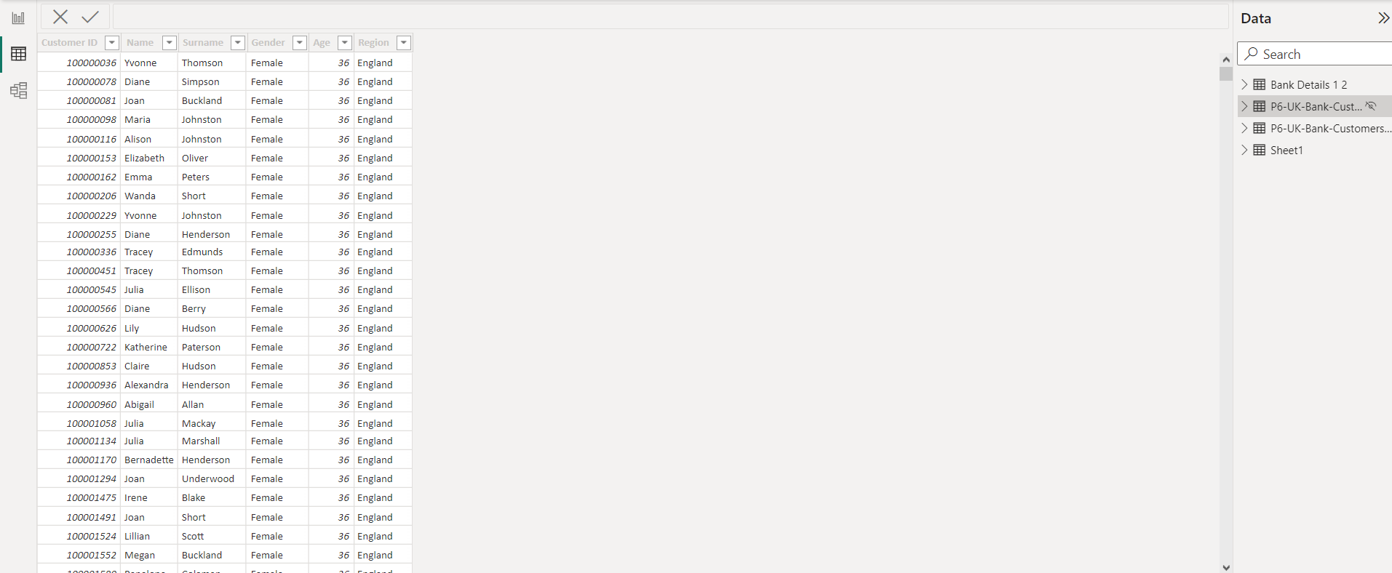
Part 1
Bank Details Data Dashboard
Bank Details sheet

Slide 3
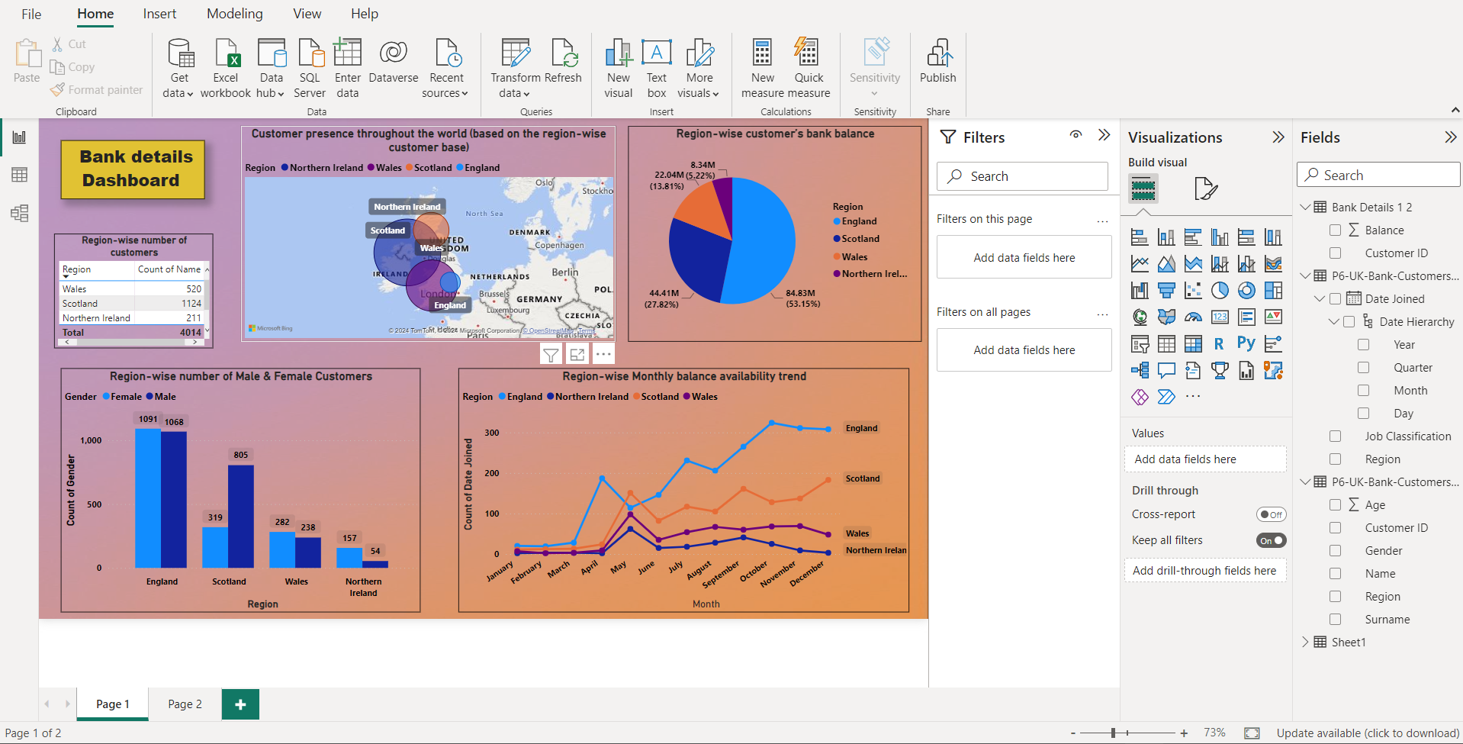
Bank Details Dashboard

Slide 4
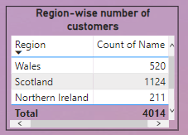
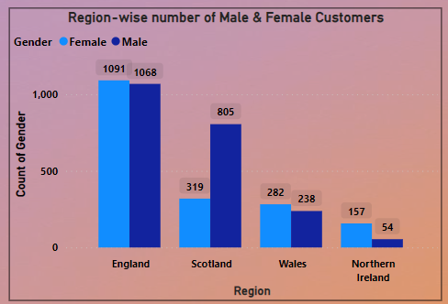
A. Region-wise number of customers
B. Region-wise number of Male & Female Customers

Slide 5
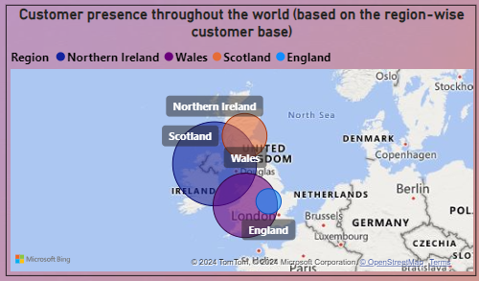
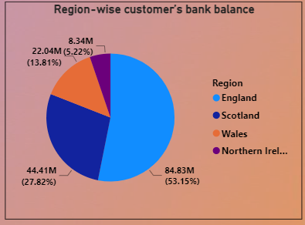
C. Customer presence throughout the world
(based on the region-wise customer base)
D. Region-wise customer’s bank balance

Slide 6
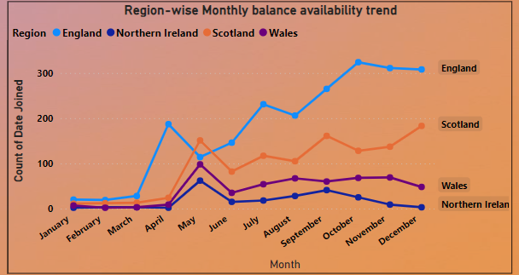
E. Region-wise Monthly balance availability trend.

Slide 7
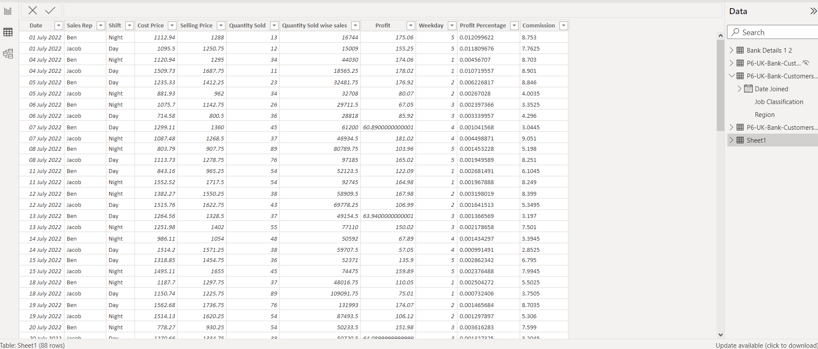
Sales Data Dashboard
Part -2
Sales Data

Slide 8
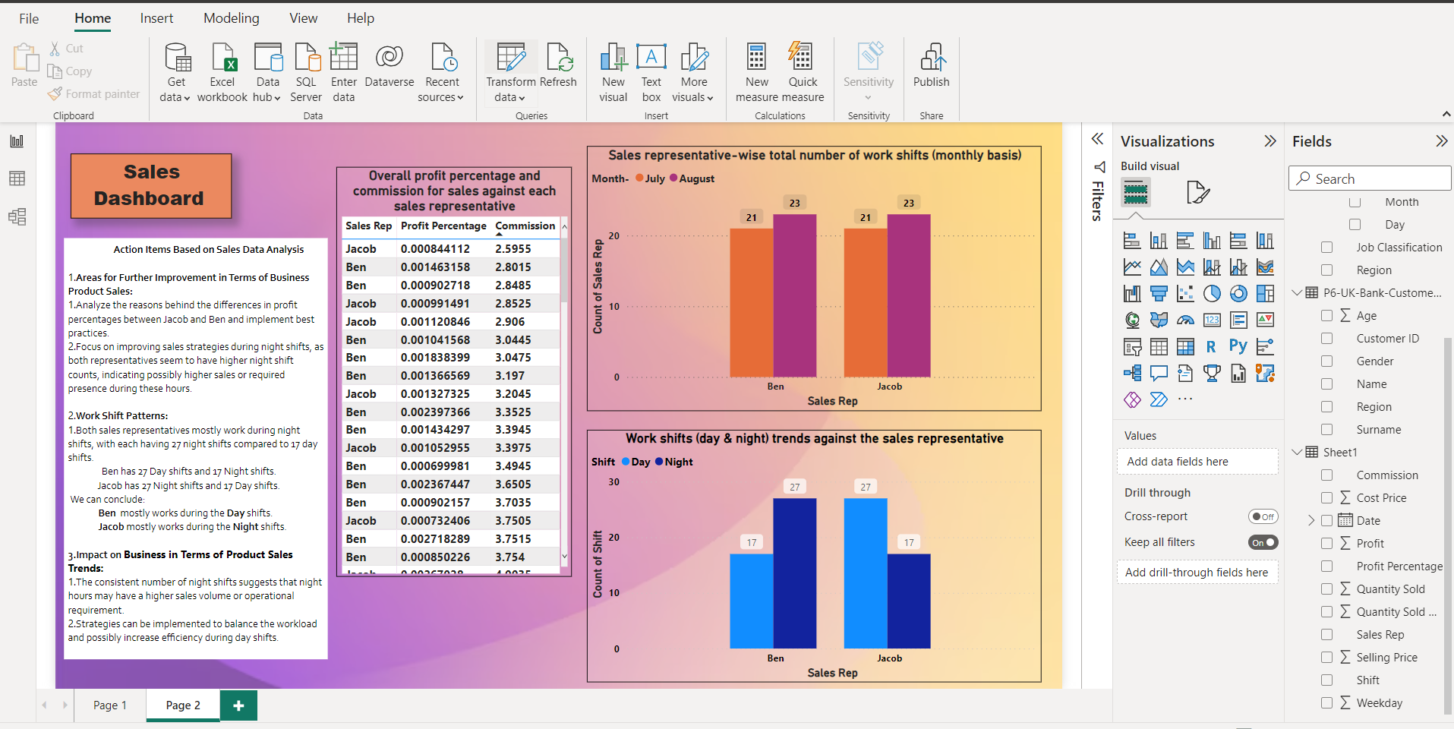
Sales Dashboard

Slide 9
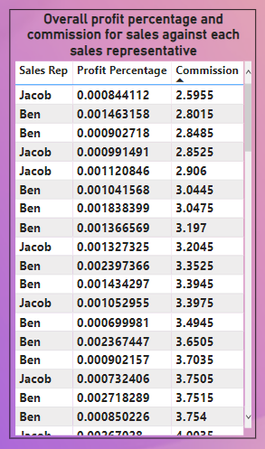
1) A. Overall profit percentage and commission for sales against each sales representative

Slide 10
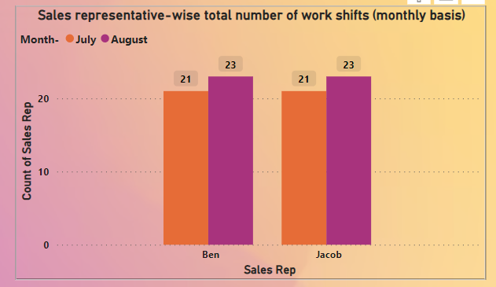
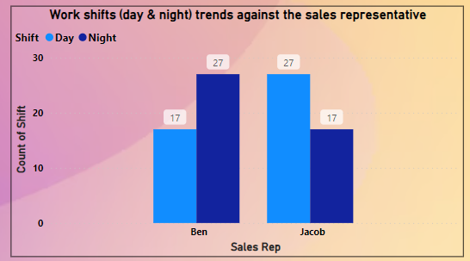
B(1). Sales representative-wise total number of work shifts (monthly basis)
B(2).Work shifts (day & night) trends against the sales representative

Slide 11
Action Items Based on Sales Data Analysis
Areas for Further Improvement in Terms of Business Product Sales:
Analyze the reasons behind the differences in profit percentages between Jacob and Ben and implement best practices.
Focus on improving sales strategies during night shifts, as both representatives seem to have higher night shift counts, indicating possibly higher sales or required presence during these hours.
Work Shift Patterns:
Both sales representatives mostly work during night shifts, with each having 27 night shifts compared to 17 day shifts.
Ben has 27 Day shifts and 17 Night shifts.
Jacob has 27 Night shifts and 17 Day shifts.
We can conclude:
Ben mostly works during the Day shifts.
Jacob mostly works during the Night shifts.
3.Impact on Business in Terms of Product Sales Trends:
The consistent number of night shifts suggests that night hours may have a higher sales volume or operational requirement.
Strategies can be implemented to balance the workload and possibly increase efficiency during day shifts.

Slide 12

THANK YOU……… ………………

